Slide 1
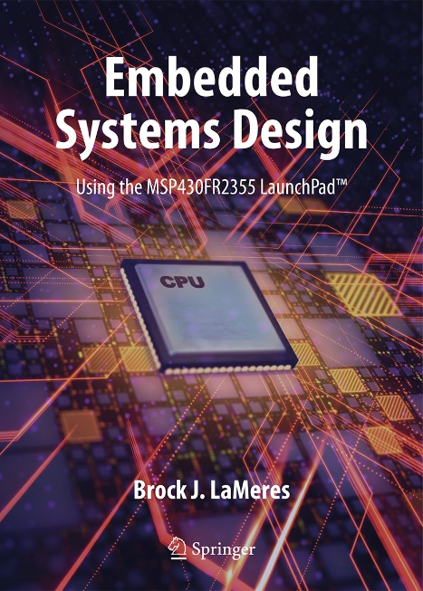

Embedded Systems Design
Chapter 3: Computer Systems
3.1 Computer Overview
Image Courtesy of
Recording Connection of Canada
Brock J. LaMeres, Ph.D.

Slide 2
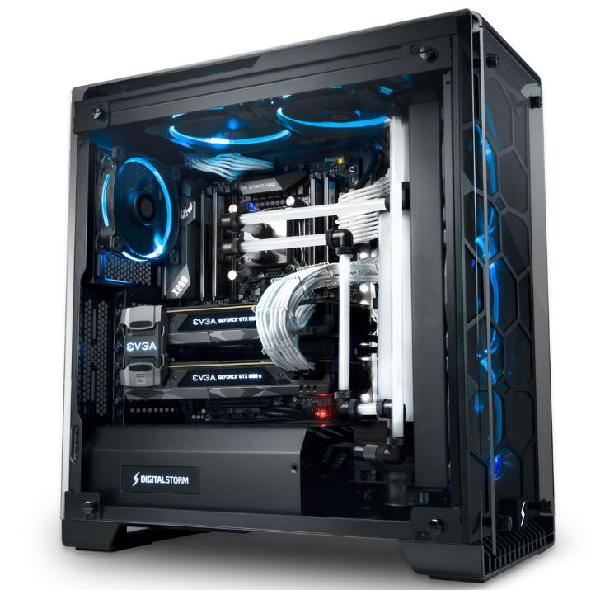
Chapter 3: Computer Systems
Computer Definitions
Computer – collection of hardware and software working together to accomplish a task.
Image Courtesy of
Recording Connection of Canada
Digital Storm Desktop Computer
https://www.digitalstorm.com/lumos.asp
3.1 Computer Overview

Slide 3
Chapter 3: Computer Systems
Computer Definitions
Computer – collection of hardware and software working together to accomplish a task.
Operation code (op-code) – a binary code that identifies the instruction.
Instruction set – a group of instructions the computer is designed to execute.
Digital Storm Desktop Computer
https://www.digitalstorm.com/lumos.asp
3.1 Computer Overview

Slide 4
Chapter 3: Computer Systems
Computer Definitions (Cont.)
Software – the sequence of instructions that when executed one-by-one, will accomplish a task.
Program – the sequence of instructions perform the task.
Software developer / programmer – a person who designs the program by deciding which instruction and in what order to use.
Image Courtesy of
Recording Connection of Canada
Digital Storm Desktop Computer
https://www.digitalstorm.com/lumos.asp
3.1 Computer Overview

Slide 5
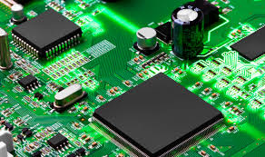
Chapter 3: Computer Systems
Computer Definitions
Hardware
- provides all the necessary functionality to store the program, retrieve the individual instructions from memory, and execute them.
- Refers to the physical components within the system.
Image Courtesy of
Recording Connection of Canada
PCB Unlimited Printed Circuit Boards
https://www.pcbunlimited.com/blog/in-case-you-didnt-know-printed-circuit-boards-are-in-almost-everything/
Digital Storm Desktop Computer
https://www.digitalstorm.com/lumos.asp
3.1 Computer Overview

Slide 6

Embedded Systems Design
Chapter 3: Computer Systems
3.1 Computer Overview
www.youtube.com/c/DigitalLogicProgramming_LaMeres
Brock J. LaMeres, Ph.D.

Slide 7
Embedded Systems Design
Chapter 3: Computer Systems
3.2 Computer Hardware
Image Courtesy of
Recording Connection of Canada
Brock J. LaMeres, Ph.D.

Slide 8
Chapter 3: Computer Systems
3.2 Computer Hardware

Slide 9
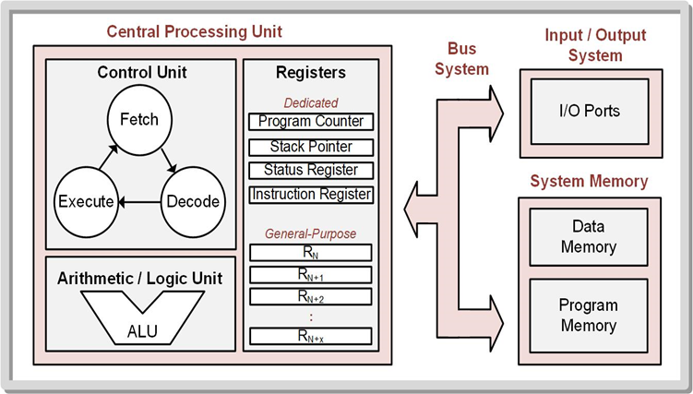
Chapter 3: Computer Systems
3.2.1 Program Memory
The storage system that holds the instruction.
Treated as read only memory during execution to prevent instructions from being overwritten.
Programs stored on non- volatile memory, so the computer system does not lose its program when power is removed.
Most computers implement program memory on an EEPROM – can be read from during normal operations but can only be written to using a dedicated procedure.
3.2 Computer Hardware

Slide 10
Chapter 3: Computer Systems
3.2.2 Data Memory
Used to hold temporary variables that are created by the software program.
Can be written to and read from during normal operation.
Implemented with read/write memory.
“RAM” refers to the data memory of a computer.
Image Courtesy of
Recording Connection of Canada
3.2 Computer Hardware

Slide 11
Chapter 3: Computer Systems
3.2.3 Central Processing Unit
Reads instructions from memory, decodes the op-code to determine the instruction is being performed, and executes the necessary steps to complete the instruction.
Contains registers that are used for general purpose data storage, operational information, and system status.
Contains circuitry to perform arithmetic and logic operations on data.
Image Courtesy of
Recording Connection of Canada
3.2 Computer Hardware

Slide 12
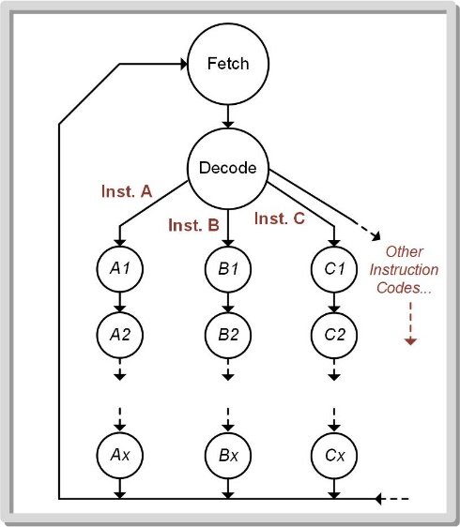
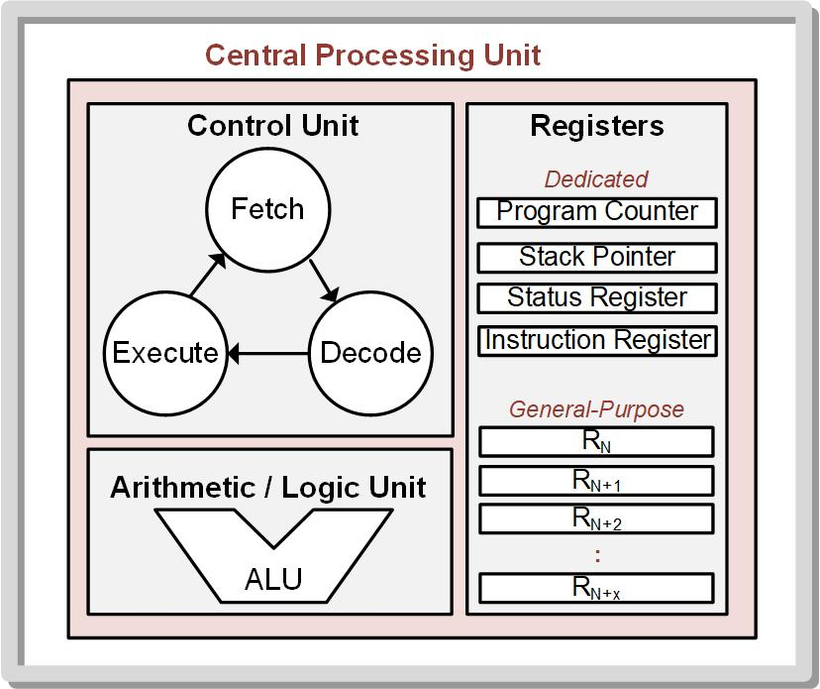
Chapter 3: Computer Systems
3.2.3 Central Processing Unit
3.2.3.1 Control Unit
Finite state machine that controls the operation of the computer by fetching the instruction, decoding the instruction op-code, and executing the appropriate steps to accomplish the functionality of the instruction.
Image Courtesy of
Recording Connection of Canada
3.2 Computer Hardware

Slide 13
Chapter 3: Computer Systems
3.2.3 Central Processing Unit
3.2.3.2 Registers
Execute instructions and hold status information.
Dedicated Registers – used as part of the normal operation of the computer and are not under the control of the program.
General-purpose Registers – used by the program as needed.
Image Courtesy of
Recording Connection of Canada
3.2 Computer Hardware

Slide 14
Chapter 3: Computer Systems
3.2.3 Central Processing Unit
3.2.3.2 Registers (Cont.)
Program Counter (PC) – holds the address of the next instruction in program memory to execute.
Image Courtesy of
Recording Connection of Canada
3.2 Computer Hardware

Slide 15
Chapter 3: Computer Systems
3.2.3 Central Processing Unit
3.2.3.2 Registers (Cont.)
Program Counter (PC) – holds the address of the next instruction in program memory to execute.
Stack Pointer (SP) – provides a way to dynamically allocate variable space in the data memory without having to keep track of specific addresses.
Image Courtesy of
Recording Connection of Canada
3.2 Computer Hardware

Slide 16
Chapter 3: Computer Systems
3.2.3 Central Processing Unit
3.2.3.2 Registers (Cont.)
Status Register (SR) – contains flags that are asserted when various conditions occur during the execution of the program.
Image Courtesy of
Recording Connection of Canada
3.2 Computer Hardware

Slide 17
Chapter 3: Computer Systems
3.2.3 Central Processing Unit
3.2.3.2 Registers (Cont.)
Status Register (SR) – contains flags that are asserted when various conditions occur during the execution of the program.
Instruction Register (IR) – holds the op-code/operand that is fetched from program memory.
Image Courtesy of
Recording Connection of Canada
3.2 Computer Hardware

Slide 18
Chapter 3: Computer Systems
3.2.3 Central Processing Unit
3.2.3.2 Registers (Cont.)
General Purpose Registers – can be accessed directly by the program.
Image Courtesy of
Recording Connection of Canada
3.2 Computer Hardware

Slide 19
Chapter 3: Computer Systems
3.2.3 Central Processing Unit
3.2.3.3 Arithmetic Logic Unit (ALU)
The system that performs all mathematical and logic operations.
Contains logic to produce status bits that provide the ability for subsequent instructions to react to particular results.
Image Courtesy of
Recording Connection of Canada
3.2 Computer Hardware

Slide 20
Chapter 3: Computer Systems
3.2.4 Input / Output Ports
Port – hardware component used to access the outside world; can be input, output, or bidirectional.
Input / Output ports – designed to pass information in parallel or serial format.
Parallel ports – pass data as a bus and allow more information to be transferred per instruction.
Serial ports – use a single line and send data bit-by-bit.
Image Courtesy of
Recording Connection of Canada
3.2 Computer Hardware

Slide 21
Chapter 3: Computer Systems
3.2.5 Bus System
Handles routing of signals between the CPU and memory.
I/O ports, data memory, and program memory share the address and data busses.
Image Courtesy of
Recording Connection of Canada
3.2 Computer Hardware

Slide 22
Chapter 3: Computer Systems
3.2.5 Bus System (Cont.)
Memory Address Bus (MAB) – provides a single address to data memory, program memory, and the I/O ports.
Memory Data Bus (MDB) – carries information back and forth between the CPU and the memory & I/O ports.
Memory map – gives all the addresses for all locations in memory.
Image Courtesy of
Recording Connection of Canada
3.2 Computer Hardware

Slide 23
Embedded Systems Design
Chapter 3: Computer Systems
3.2 Computer Hardware
www.youtube.com/c/DigitalLogicProgramming_LaMeres
Brock J. LaMeres, Ph.D.

Slide 24
Embedded Systems Design
Chapter 3: Computer Systems
3.3 Computer Software
Image Courtesy of
Recording Connection of Canada
Brock J. LaMeres, Ph.D.

Slide 25
Chapter 3: Computer Systems
3.3 Computer Software

Slide 26
Chapter 3: Computer Systems
RISC vs. CISC
RISC (Reduced Instruction
Set Computer)
Small number of instructions.
CISC (Complex Instruction
Set Computer)
Large number of instructions.
3.3 Computer Software

Slide 27
Chapter 3: Computer Systems
RISC vs. CISC
RISC (Reduced Instruction
Set Computer)
Small number of instructions.
Reduces the size of the needed circuitry in the CPU.
Executes instructions very quickly.
Requires a large number of operations to accomplish a given task.
CISC (Complex Instruction
Set Computer)
Large number of instructions.
Increased physical size of the computer.
Executes instructions very quickly .
Requires fewer number of instructions to accomplish a given task.
3.3 Computer Software

Slide 28
Chapter 3: Computer Systems
3.3.1 Classes of Instructions
3.3.1.1 Data Movement Instructions
Move information between the CPU and memory or between two memory locations.
Do not use the ALU.
Assert control signals within the bus system to facilitate the routing and storing of information between a source and destination.
3.3 Computer Software

Slide 29
Chapter 3: Computer Systems
3.3.1 Classes of Instructions
3.3.1.2 Data Manipulation Instructions
Use the ALU to perform arithmetic or logical operations on information.
Examples: addition, subtraction, ANDs, XORs, increments, decrements, bit-sets, and bit-clears.
3.3 Computer Software

Slide 30
Chapter 3: Computer Systems
3.3.1 Classes of Instructions
3.3.1.3 Program Flow Instructions
Provide the ability to alter the program counter to support looping and conditional statement functionality.
Unconditional program flow – always change the program counter to a fixed value.
Conditional program flow – only alter the program counter when certain conditions exist within the status register.
3.3 Computer Software

Slide 31

Chapter 3: Computer Systems
3.3.2 Op-codes
Unique binary code given to each instruction in the set.
Mnemonic – a descriptive name for the op-code that can be used when discussing the instruction functionally.
Assembly – low-level language that uses mnemonics to communicate which instruction is being talked about.
Assembler – translates the mnemonics and additional information for each instruction into its specific op-code.
Image Courtesy of https://neodem.wp.horizon.ac.uk/
Image Courtesy of
Recording Connection of Canada
3.3 Computer Software

Slide 32
Chapter 3: Computer Systems
3.3.2 Operands
Provides additional information needed to complete the instruction.
May include moving/copying information:
From memory into any of the general-purpose CPU registers.
From any CPU register into memory.
Between any two CPU registers.
Between any two memory locations.
Image Courtesy of https://neodem.wp.horizon.ac.uk/
Image Courtesy of
Recording Connection of Canada
3.3 Computer Software

Slide 33
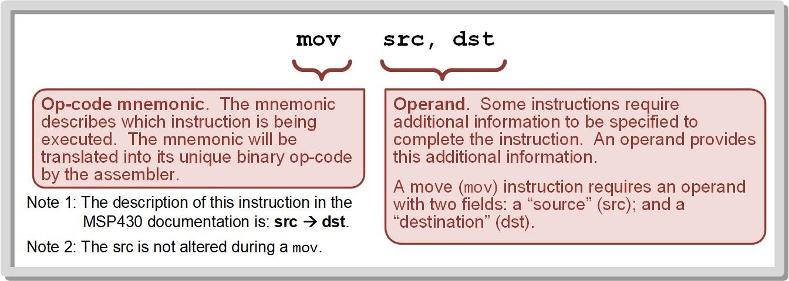
Chapter 3: Computer Systems
3.3.2 Op-Codes and Operands
Image Courtesy of https://neodem.wp.horizon.ac.uk/
Image Courtesy of
Recording Connection of Canada
3.3 Computer Software

Slide 34
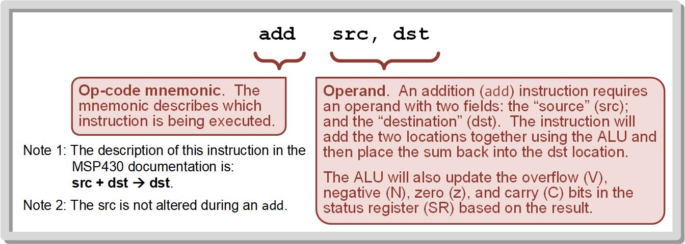
Chapter 3: Computer Systems
3.3.2 Op-Codes and Operands
Image Courtesy of https://neodem.wp.horizon.ac.uk/
Image Courtesy of
Recording Connection of Canada
3.3 Computer Software

Slide 35
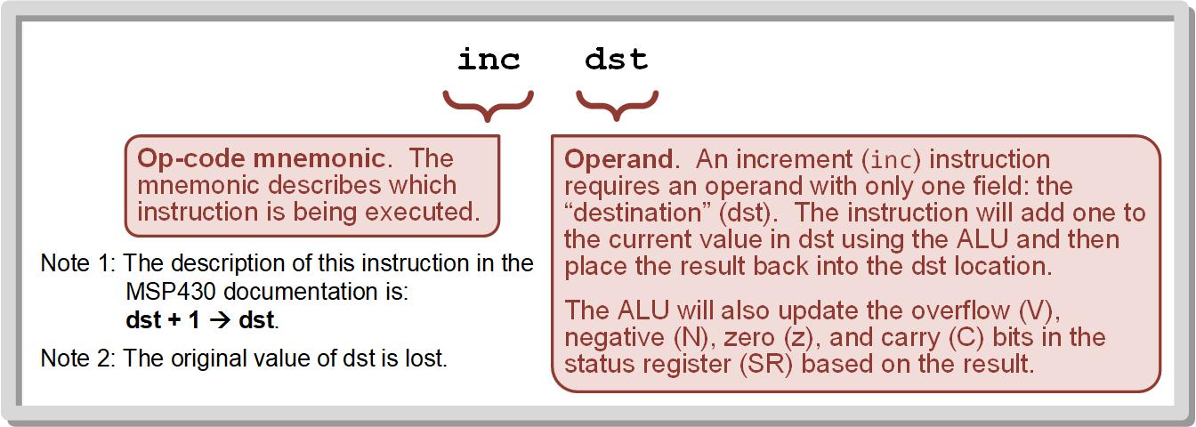
Chapter 3: Computer Systems
3.3.2 Op-Codes and Operands
Image Courtesy of https://neodem.wp.horizon.ac.uk/
Image Courtesy of
Recording Connection of Canada
3.3 Computer Software

Slide 36
Chapter 3: Computer Systems
3.3.3 Program Development Flow
At the highest level of program development, the language C can be used to develop programs without needing to understand the architecture of the CPU or how the internal registers are used to move and manipulate data.
Complier – used to convert high-level programming constructs into individual assembly language instructions.
Image Courtesy of https://neodem.wp.horizon.ac.uk/
Image Courtesy of
Recording Connection of Canada
3.3 Computer Software

Slide 37
Chapter 3: Computer Systems
3.3.3 Program Development Flow (Cont.)
In assembly language programming, each instruction is listed in a file using the mnemonic with the associated operands. Additionally, information can be provided in an assembly file that will dictate memory allocation for variables.
Assembler – used to translate the instruction mnemonics and operands into their corresponding binary codes.
Image Courtesy of https://neodem.wp.horizon.ac.uk/
Image Courtesy of
Recording Connection of Canada
3.3 Computer Software

Slide 38
Chapter 3: Computer Systems
3.3.3 Program Development Flow (Cont.)
Linker – a tool within the development flow that joins multiple source files and assigns the final addresses for the program code.
The output of the linker stage is an executable object file that is ready to be downloaded to the MSP430 using the EEPROM programmer.
Debugger – a tool that allows the program to be executed instruction-by-instruction (stepped) and the values within the CPU registers and memory to be observed as instructions are executed
Image Courtesy of https://neodem.wp.horizon.ac.uk/
Image Courtesy of
Recording Connection of Canada
3.3 Computer Software

Slide 39
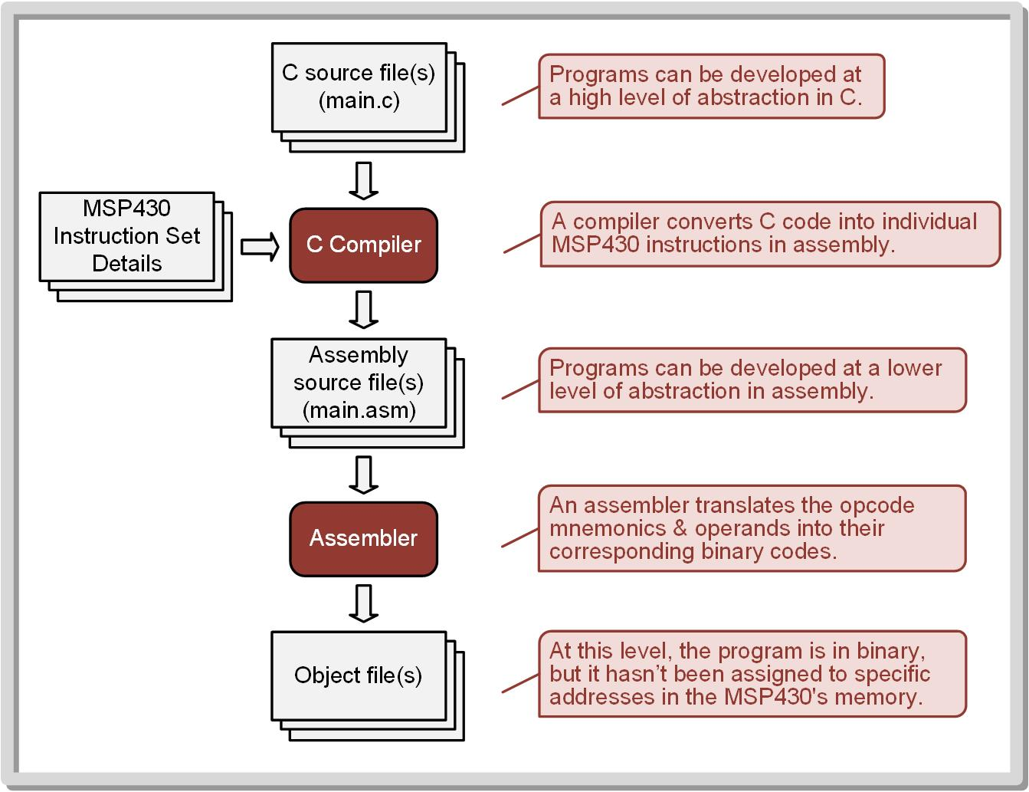
Chapter 3: Computer Systems
3.3.3 Program Development Flow
Image Courtesy of
Recording Connection of Canada
3.3 Computer Software

Slide 40
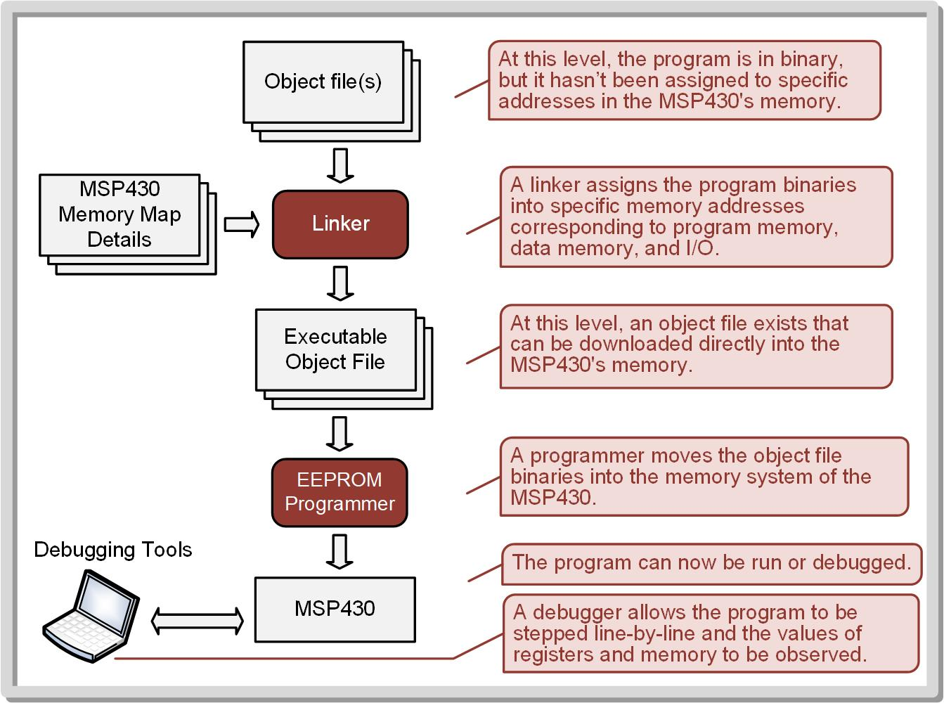
Chapter 3: Computer Systems
3.3.3 Program Development Flow
Image Courtesy of
Recording Connection of Canada
3.3 Computer Software

Slide 41
Embedded Systems Design
Chapter 3: Computer Systems
3.3 Computer Software
www.youtube.com/c/DigitalLogicProgramming_LaMeres
Brock J. LaMeres, Ph.D.

